Slide 1
Calculation of Operational Amplifier
Zhiqing Yang

Slide 2






Calculation of Operational Amplifier
Inverting amplifier
$$R_{i}$$
$$R_{f}$$
$$V_{i}$$
$$V_{o}$$
$$\frac{V_{i}}{R_{i}}+\frac{V_{o}}{R_{f}}=0$$
$$V_{o}=−\frac{R_{f}}{R_{i}}∙V_{i}$$

Slide 3





Calculation of Operational Amplifier
Non-inverting amplifier
$$R_{i}$$
$$R_{f}$$
$$V_{+}$$
$$V_{o}$$
$${V_{+}=V}_{i}$$
$$V_{i}$$
$$\frac{V_{+}}{R_{i}}=\frac{V_{o}}{R_{f}+R_{i}}$$
$$V_{o}=\left(1+\frac{R_{f}}{R_{i}}\right)∙V_{i}$$

Slide 4

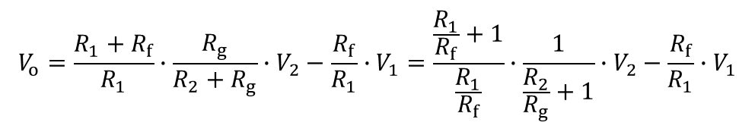








Calculation of Operational Amplifier
Differential amplifier
Inverting + non-inverting
If consider $\frac{R_{1}}{R_{f}}=\frac{R_{2}}{R_{g}}$
$$R_{1}$$
$$R_{f}$$
$$V_{+}=\frac{R_{g}}{R_{2}+R_{g}}∙V_{2}$$
$$V_{1}$$
$$V_{+}$$
$$V_{o}$$
$$V_{2}$$
$$R_{2}$$
$$R_{g}$$
$$V_{o}=\frac{{R_{1}+R}_{f}}{R_{1}}∙V_{+}−\frac{R_{f}}{R_{1}}∙V_{1}$$
$$V_{o}=\frac{{R_{1}+R}_{f}}{R_{1}}∙\frac{R_{g}}{R_{2}+R_{g}}∙V_{2}−\frac{R_{f}}{R_{1}}∙V_{1}=\frac{\frac{R_{1}}{R_{f}}+1}{\frac{R_{1}}{R_{f}}}∙\frac{1}{\frac{R_{2}}{R_{g}}+1}∙V_{2}−\frac{R_{f}}{R_{1}}∙V_{1}$$
$$V_{o}=\frac{R_{1}}{R_{f}}∙(V_{2}−V_{1})$$

Slide 5
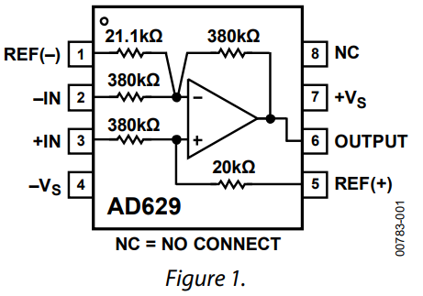













Calculation of Operational Amplifier
AD629
Function: differential voltage measurement
Apply to $±270 V$ common mode voltage
The signal at $V_{2}$ is attenuated by a factor of 20
Then amplified by 20 with $V_{1}$
$$21.1 k$$
$$380 k$$
$$380 k$$
$$V_{+}=\frac{20 k}{380 k +20 k}∙V_{2}=\frac{1}{40}∙V_{2}$$
$$V_{1}$$
$$V_{+}$$
$$V_{o}$$
$$V_{2}$$
$$380 k$$
$$20 k$$
$$\frac{V_{1}−V_{+}}{380 k}+\frac{0−V_{+}}{21.1 k}+\frac{V_{o}−V_{+}}{380 k}=0$$
$$V_{o}=V_{2}−V_{1}$$
Source: https://www.analog.com/media/en/technical-documentation/data-sheets/AD629.pdf

Slide 6
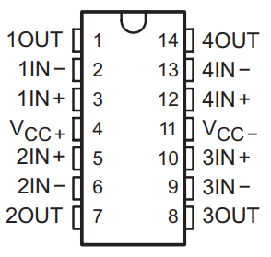










Calculation of Operational Amplifier
TL084
Function: voltage scale and shift
One IC contains four Ops
Consider analog input of TI LaunchPad $0−3 V$
$V_{r}=1.5 V$
$\frac{R_{2}}{R_{1}}$ is selected according to $V_{m}$ acquired by the sensor
$$R_{1}$$
$$R_{2}$$
$$V_{+}$$
$$V_{o}$$
$$V_{+}=V_{r}+\frac{R_{2}}{R_{1}+R_{2}}∙(V_{m}−V_{r})$$
$$V_{m}$$
$$R_{1}$$
$$R_{2}$$
$$\frac{V_{o}}{R_{1}+R_{2}}=\frac{V_{+}}{R_{1}}$$
$$V_{r}$$
$$V_{o}=V_{r}+\frac{R_{2}}{R_{1}}∙V_{m}$$
Source: https://www.ti.com/general/docs/suppproductinfo.tsp?distId=26&gotoUrl=http%3A%2F%2Fwww.ti.com%2Flit%2Fgpn%2Ftl084

